Slide 1
PARBA 2.0 Nigel Wang
Dec 4th, 2013

Slide 2
Outline – Now only for tile build section
1 Requirement
2 Overview
3 Describe info from pd xml
4 Running command
5 Detaill analyze
6 Potential Issue

Slide 3
FLOW MECHANICS
New Port Feed
Will read xml file add ports to tile for feedthru ports.
After all tiles are updated flow will add these connections to a new core.v.
RTL_BIA.v
RTL_NEW.v
X
core_new.v
RTL_NEW.v
GATE.v
New connections

Slide 4
PD XML Introduction
For new PARBA Flow we need to get pd xml’s enhancement for support , here are simple example from pd xml
This format is very important for the whole flow:
<net bundle="TST_TILE70_EdtChannels" matched="1" maxdist="3076.468" name="TST_TILE70_EdtChannels_In[9]" pdestimate="0" rep_type="">
<instTerm fullOrder="1" direction="output" name="usblk_sat_dft4/TST_TILE70_EdtChannels_In[9]" parentInstance="usblk_sat_dft4" port="TST_TILE70_EdtChannels_In[9]" />
<instTerm fullOrder="2" direction="input" name="usblk_tcca1/FE_FEEDX_P_TST_TILE70_EdtChannels_In_9_" parentInstance="usblk_tcca1" port="FE_FEEDX_P_TST_TILE70_EdtChannels_In_9_" />
<repInstance fullOrder="3" clampValue="" clamped="false" id="4318" instName="FCFPRepFFedtGFX4318" order="1" parentInstance="usblk_tcca1" pwrdomain="PD_GLB" scan_enable_type="input" usageCount="1" />
<repInstance fullOrder="4" clampValue="" clamped="false" id="4319" instName="FCFPRepFFedtGFX4319" order="2" parentInstance="usblk_tcca1" pwrdomain="PD_GLB" scan_enable_type="output" usageCount="1" />
<bufInstance fullOrder="5" clampValue="" clamped="false" instName="FCFPRepFFedtGFX4319outputBuffer" order="3" parentInstance="usblk_tcca1" pwrdomain="usblk_tcca1/PD_GLB" />
<instTerm fullOrder="6" direction="output" name="usblk_tcca1/FE_FEEDX_MFT_sblk_tcca1__sblk_sp1_0__0_TST_TILE70_EdtChannels_In_9_" parentInstance="usblk_tcca1" port="FE_FEEDX_MFT_sblk_tcca1__sblk_sp1_0__0_TST_TILE70_EdtChan
nels_In_9_" />

Slide 5
Running Command
Test running command :
lsf_bsub -Is -P vcoe-ver -q normal -R "select[type==RHEL5_64] rusage[mem=4000]" "perl /proj/srdc_web_root/niwang_tree/carrizo/main/import/stdgen/src/tools/connectivity/rtl_repeater_insertion/repeater_flow/scripts/rtl_repeater_insertion.pl -input /proj/srdc_web_root/niwang_tree/carrizo/main/out/linux_2.6.18_64.VCS/carrizo/common/tmp/import/stdgen/src/tools/connectivity/bia_ifrit_verilog_ctnr_tile/test_ni_03.vf -xml $STEM/pd/nl/floorplan/gnb_expandRepeaterReport.xml.gz -output_vf output_rep_inserted.vf -top MPU |tee final16.log“
Official command:
cd $STEM/import/stdgen/src/tools/connectivity/rtl_repeater_insertion/ do hb;

Slide 6
Detail analyze
Sub_block Generation
Get all tile related inst info by order from new pd xml
Collect clock related info from new pd xml
Generate sub_block name by power domain_info
Generate wire and port related info
Generate flip_flop based on 1 and 2

Slide 7
Detail analyze
Tile level sub_block ports connection
Introduction for all sub_block port connection
There are 3 condition for sub_block port connect in tile level , detail will be at follow up page and cae example .

Slide 8
Detail analyze
Tile level sub_block ports connection
Condition 1
Condition 2
tile
tile
exist_port
repeater
New_created
repeater

Slide 9
Detail analyze
Tile level sub_block ports connection
Condition 3
tile
repeater
new created port

Slide 10
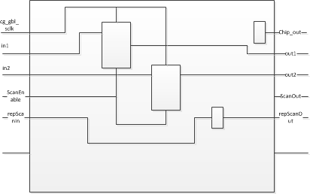
Detail analyze
Tile level sub_block ports connection
An Example -old tile rtl

Slide 11
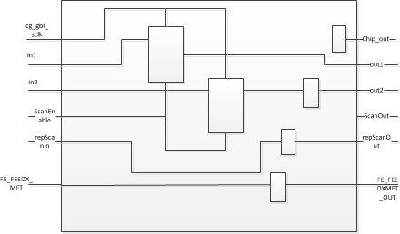
Detail analyze
Tile level sub_block ports connection
An Example -new circuit diagram

Slide 12
Detail analyze
Tile level sub_block ports connection
Example from carrriao
Pay attention to below pd.xml
<rep constraint="EQ 4" container="gnb" contract="424" domain="edtGFX" file="/proj/cz_rtl_rel/bpunia/FILELIST/NLD/ws_278336/out/linux_2.6.18_64.VCS/carrizo/library/gnb-carrizo/pub/src/meta/connectivity/bia_repeaters_scan.xml" l
imited="False" negedge="false" pd="4" rep_inst="gnb_rep_cg_gfx_sclk" scanned="" sdc_clk="GNB_SC2_EDTCLK">
<net bundle="TST_TILE71_EdtChannels" matched="1" maxdist="1026.949" name="TST_TILE71_EdtChannels_In[0]" pdestimate="0" rep_type="rep">
<instTerm fullOrder="1" direction="output" name="usblk_sat_dft4/TST_TILE71_EdtChannels_In[0]" parentInstance="usblk_sat_dft4" port="TST_TILE71_EdtChannels_In[0]" />
<instTerm fullOrder="2" direction="input" name="usblk_tcca1/TST_TILE_EdtChannels_In[0]" parentInstance="usblk_tcca1" port="TST_TILE_EdtChannels_In[0]" />
<repInstance fullOrder="3" clampValue="" clamped="false" id="4438" instName="FCFPRepFFedtGFX4438" order="1" parentInstance="usblk_tcca1" pwrdomain="PD_GLB" scan_enable_type="input" usageCount="1" />
<repInstance fullOrder="4" clampValue="" clamped="false" id="4439" instName="FCFPRepFFedtGFX4439" order="2" parentInstance="usblk_tcca1" pwrdomain="PD_GLB" scan_enable_type="core" usageCount="1" />
<repInstance fullOrder="5" clampValue="" clamped="false" id="4440" instName="FCFPRepFFedtGFX4440" order="3" parentInstance="usblk_tcca1" pwrdomain="PD_GLB" scan_enable_type="core" usageCount="1" />
<repInstance fullOrder="6" clampValue="" clamped="false" id="4441" instName="FCFPRepFFedtGFX4441" order="4" parentInstance="usblk_tcca1" pwrdomain="PD_GLB" scan_enable_type="core" usageCount="1" />
</net>

Slide 13
Detail analyze
Tile level sub_block ports connection
From tile level rtl
Old RTL:
input [ 8:0] TST_TILE_EdtChannels_In;
dummy_dft_width9 dummy_dft_usblk_tcca(
….
,.TST_TILE_EdtChannels_In(TST_TILE_EdtChannels_In)
…
)

Slide 14
Detail analyze
Tile level sub_block ports connection
From tile level rtl
New tile RTL :
input [8:0] TST_TILE_EdtChannels_In ;
.FCFPRepFFedtGFX4438_in(TST_TILE_EdtChannels_In[0]),
dummy_dft_width9 dummy_dft_usblk_tcca(
….
.TST_TILE_EdtChannels_In[0] (FCFPRepFFedtGFX4441_out),
wire FCFPRepFFedtGFX4441_out ;
…
)

Slide 15
Detail analyze
Tile level sub_block ports connection
From tile level rtl
New tile RTL :
Pwr_
sblk_tcca1_pwr_PD_P1 sblk_tcca1_pwr_PD_P1 ( …
.FCFPRepFFedtGFX4441_out(FCFPRepFFedtGFX4441_out),
…)
output FCFPRepFFedtGFX4441_out;
reg FCFPRepFFedtGFX4441_out;
input FCFPRepFFedtGFX4438_in;
always @(posedge GNB_SC2_EDTCLK) begin
FCFPRepFFedtGFX4438_out <= FCFPRepFFedtGFX4438_in;
FCFPRepFFedtGFX4439_out <= FCFPRepFFedtGFX4438_out;
FCFPRepFFedtGFX4440_out <= FCFPRepFFedtGFX4439_out;
FCFPRepFFedtGFX4441_out <= FCFPRepFFedtGFX4440_out;
end

Slide 16
Detail analyze
Tile level sub_block ports connection
Example from carrriao
Pay attention to below pd.xml
<net bundle="sblk_mc_vdcigfx_xover_vddgfx_TAP_TAP_rdret_mcc1tc1" matched="1" maxdist="18193.113" name="sblk_mc_vdcigfx_xover_vddgfx_TAP_TAP_rdr
et_mcc1tc1_data[4]" pdestimate="5" rep_type="rep">
<instTerm fullOrder="48" direction="input" name="usblk_tcca1/FE_FEEDX_MFT_sblk_cpg__sblk_tcca1__0_sblk_mc_vdcigfx_xover_vddgfx_TAP_TAP_rdret_
mcc1tc1_data_4_" parentInstance="usblk_tcca1" port="FE_FEEDX_MFT_sblk_cpg__sblk_tcca1__0_sblk_mc_vdcigfx_xover_vddgfx_TAP_TAP_rdret_mcc1tc1_data_4_
" />
<repInstance fullOrder="49" clampValue="" clamped="false" id="27321" instName="FCFPRepFFsysGFX27321" order="23" parentInstance="usblk_tcca1"
pwrdomain="PD_GLB" scan_enable_type="input" usageCount="1" />
<bufInstance fullOrder="50" clampValue="" clamped="false" instName="FCFPRepFFsysGFX27321outputBuffer" order="24" parentInstance="usblk_tcca1"
pwrdomain="usblk_tcca1/PD_GLB" />
<instTerm fullOrder="51" direction="output" name="usblk_tcca1/FE_FEEDX_MFT_sblk_tcca1__sblk_tcci__0_sblk_mc_vdcigfx_xover_vddgfx_TAP_TAP_rdre
t_mcc1tc1_data_4_" parentInstance="usblk_tcca1" port="FE_FEEDX_MFT_sblk_tcca1__sblk_tcci__0_sblk_mc_vdcigfx_xover_vddgfx_TAP_TAP_rdret_mcc1tc1_data
_4_" />
<instTerm fullOrder="52" direction="input" name="usblk_tcci/TAP_TAP_rdret_in_data[4]" parentInstance="usblk_tcci" port="TAP_TAP_rdret_in_data
[4]" />
</net>

Slide 17
Detail analyze
Tile level sub_block ports connection
From tile level rtl
Old RTL:
module sblk_tcca1 (
)

Slide 18
Detail analyze
Tile level sub_block ports connection
From tile level rtl
New tile RTL :
module sblk_tcca1 (
…
FE_FEEDX_MFT_sblk_tcca1__sblk_tcci__0_sblk_mc_vdcigfx_xover_vddgfx_TAP_TAP_rdret_mcc1tc1_data_4_,
FE_FEEDX_MFT_sblk_cpg__sblk_tcca1__0_sblk_mc_vdcigfx_xover_vddgfx_TAP_TAP_rdret_mcc1tc1_data_4_,
…
)
input FE_FEEDX_MFT_sblk_cpg__sblk_tcca1__0_sblk_mc_vdcigfx_xover_vddgfx_TAP_TAP_rdret_mcc1tc1_data_4_ ;
output FE_FEEDX_MFT_sblk_tcca1__sblk_tcci__0_sblk_mc_vdcigfx_xover_vddgfx_TAP_TAP_rdret_mcc1tc1_data_4_ ;
Sblk
sblk_tcca1_pwr_PD_P1 sblk_tcca1_pwr_PD_P1 (
…
.FCFPRepFFsysGFX27321_in(FE_FEEDX_MFT_sblk_cpg__sblk_tcca1__0_sblk_mc_vdcigfx_xover_vddgfx_TAP_TAP_rdret_mcc1tc1_data_4_),
.FCFPRepFFsysGFX27321outputBuffer_out(FE_FEEDX_MFT_sblk_tcca1__sblk_tcci__0_sblk_mc_vdcigfx_xover_vddgfx_TAP_TAP_rdret_mcc1tc1_data_4_)
…
);

Slide 19
Detail analyze
Tile level sub_block ports connection
From tile level rtl
New tile RTL :
input FCFPRepFFsysGFX27321_in;
reg FCFPRepFFsysGFX27321_out;
output FCFPRepFFsysGFX27321outputBuffer_out;
reg FCFPRepFFsysGFX27321outputBuffer_out;
always @(posedge GNB_SC2_EDTCLK_edtGFX) begin
FCFPRepFFsysGFX27321_out <= FCFPRepFFsysGFX27321_in;
End
always @(*) begin
FCFPRepFFsysGFX27321outputBuffer_out = FCFPRepFFsysGFX27321_out;
end

Slide 20
Detail analyze
Top connection
How to Make top connect
tileA
tileB
tileC
out_put
in_put
out_put
in_put
wire_connect_1
wire_connect_2

Slide 21
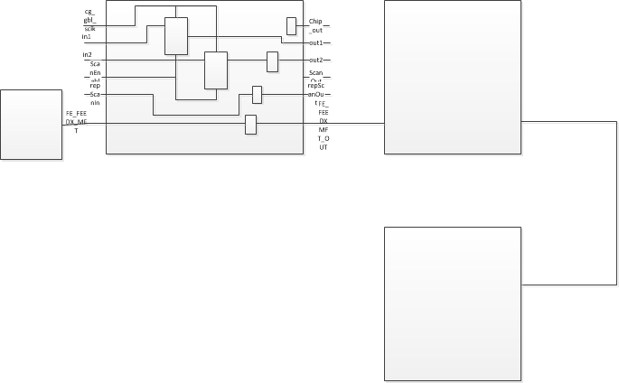
Detail analyze
Top connection
How to Make top connect

Slide 22
Detail analyze
Top level example
Full chip top level example
TBD to add

Slide 23
Detail analyze
Generate ALE
Auto generation ale
1 generate a filelist to auto publish to bia_tiled
2 modify the old ale to delete the rep shell
3 link all rtl for compile

Slide 24
Potential Issue
1 Now can pass one tile but will fail at full chip
2 Clk setting like GNB_SCLK set to GNB_SCLK_sysGFX
3 how about repeater upf generation
4 Too Slow now
5 need macro support from sim_build place
6 Depends on pd repeater xml

Slide 25
Thank You

